Slide 1
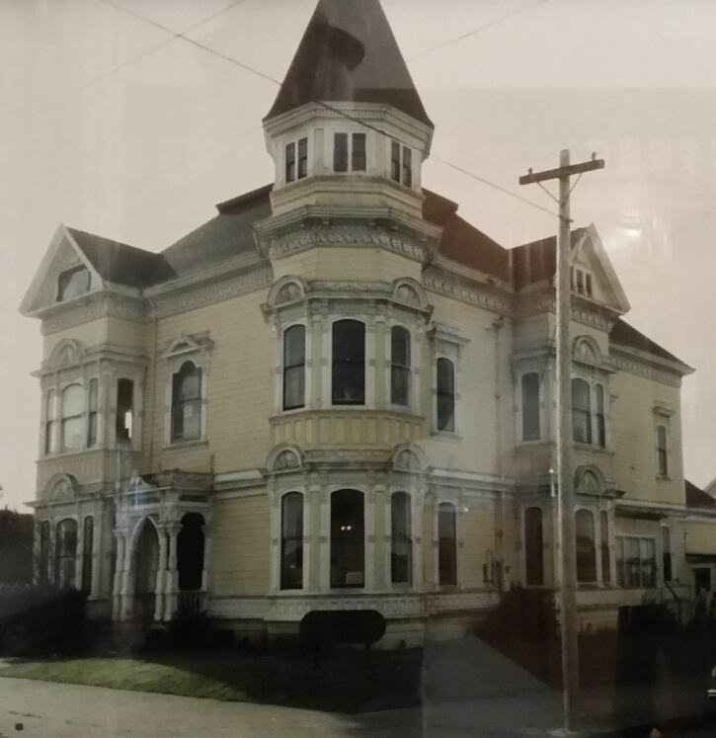
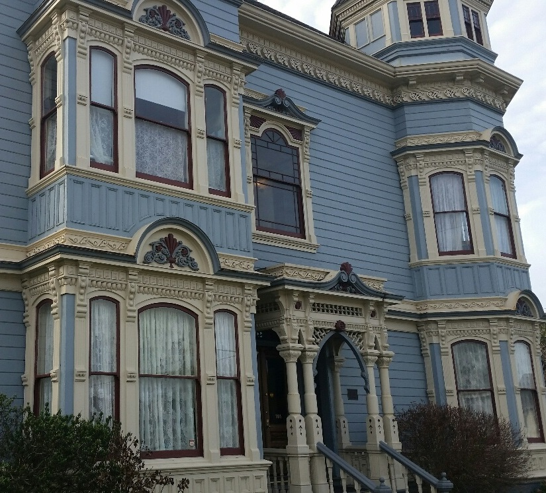
RCAA at 35 Years

Slide 2
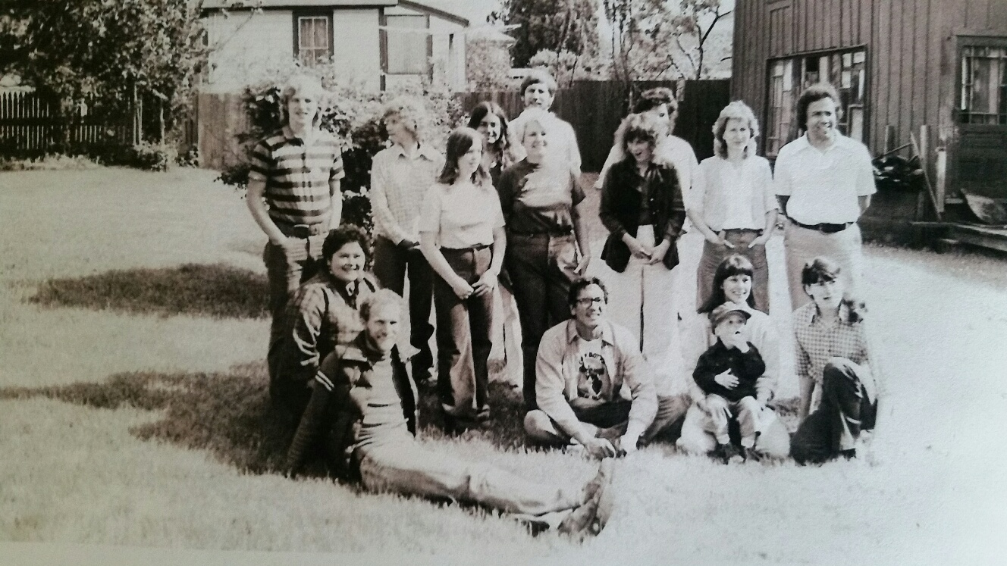
Early 1980’s RCAA Staff
Notes:
Val, Rick Littlefield, Raedelle Miller, Ron Halverson, Jackie Glen, Alan Katz, Marcie, Zuretti Goosby, Nezzie Wade, Marie Stansberry

Slide 3
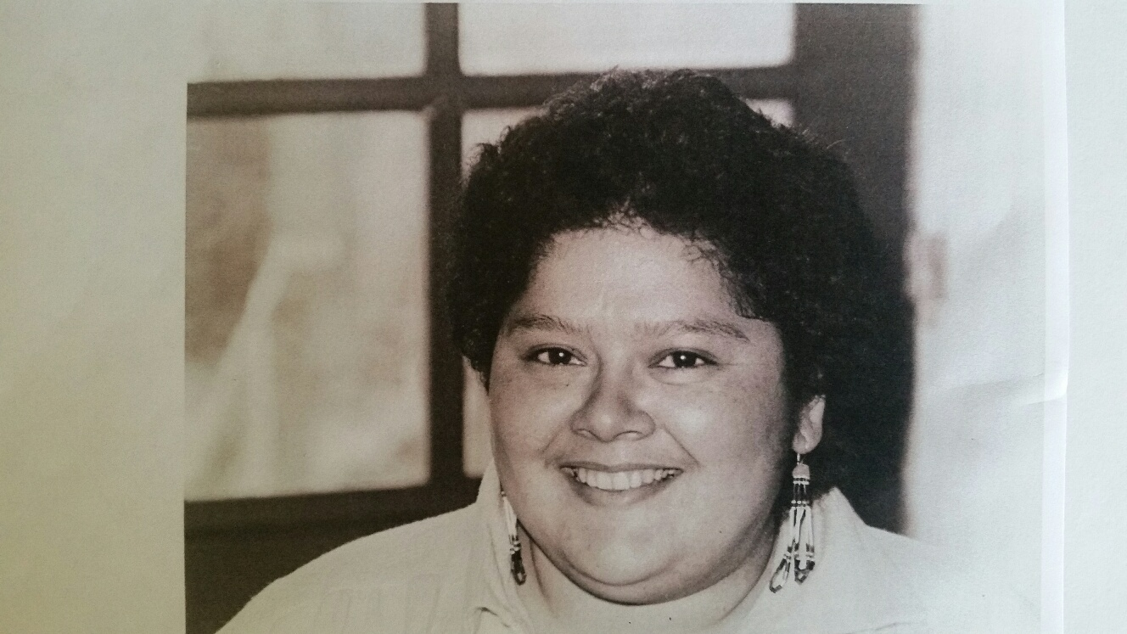
Val in 1981 as a CETA Outreach Worker

Slide 4
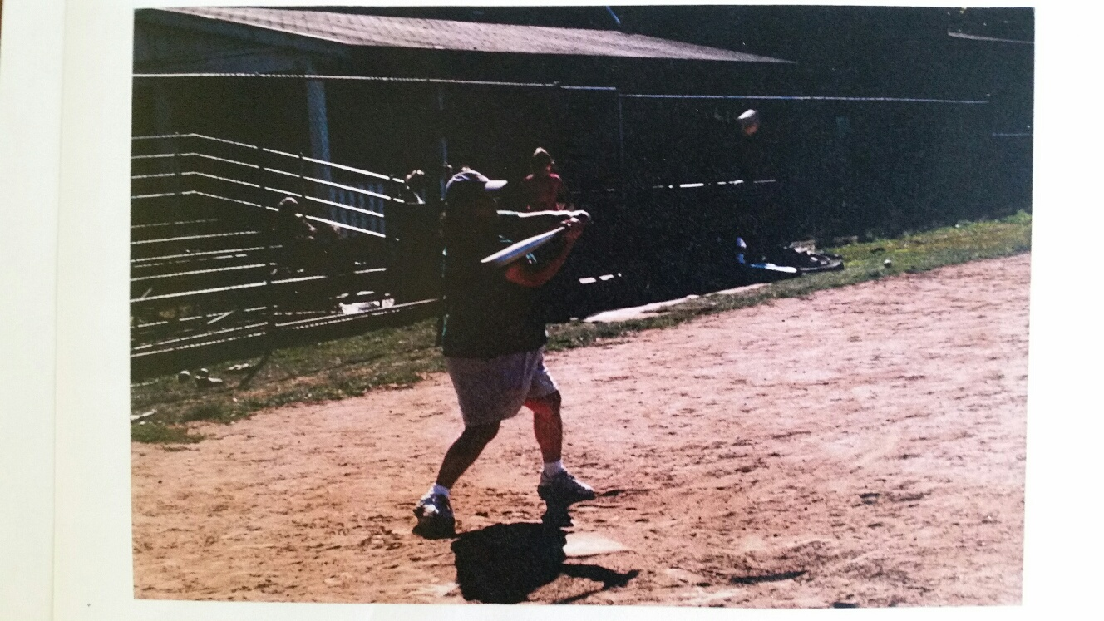
Val at the Plate!
Notes:
During a RCAA Women’s Baseball Team Game

Slide 5
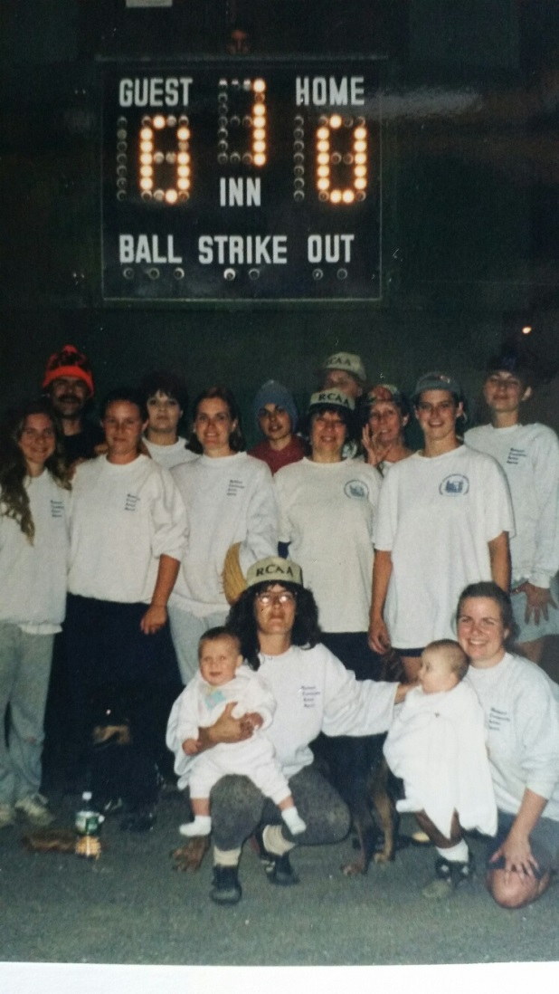
RCAA Women’s Baseball Team

Slide 6
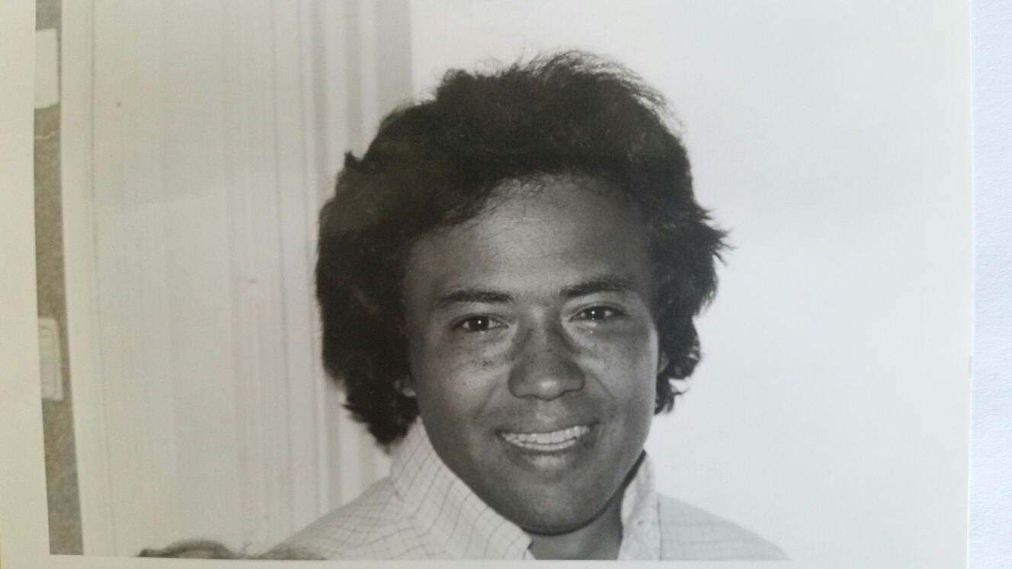
Executive Director Goosby

Slide 7
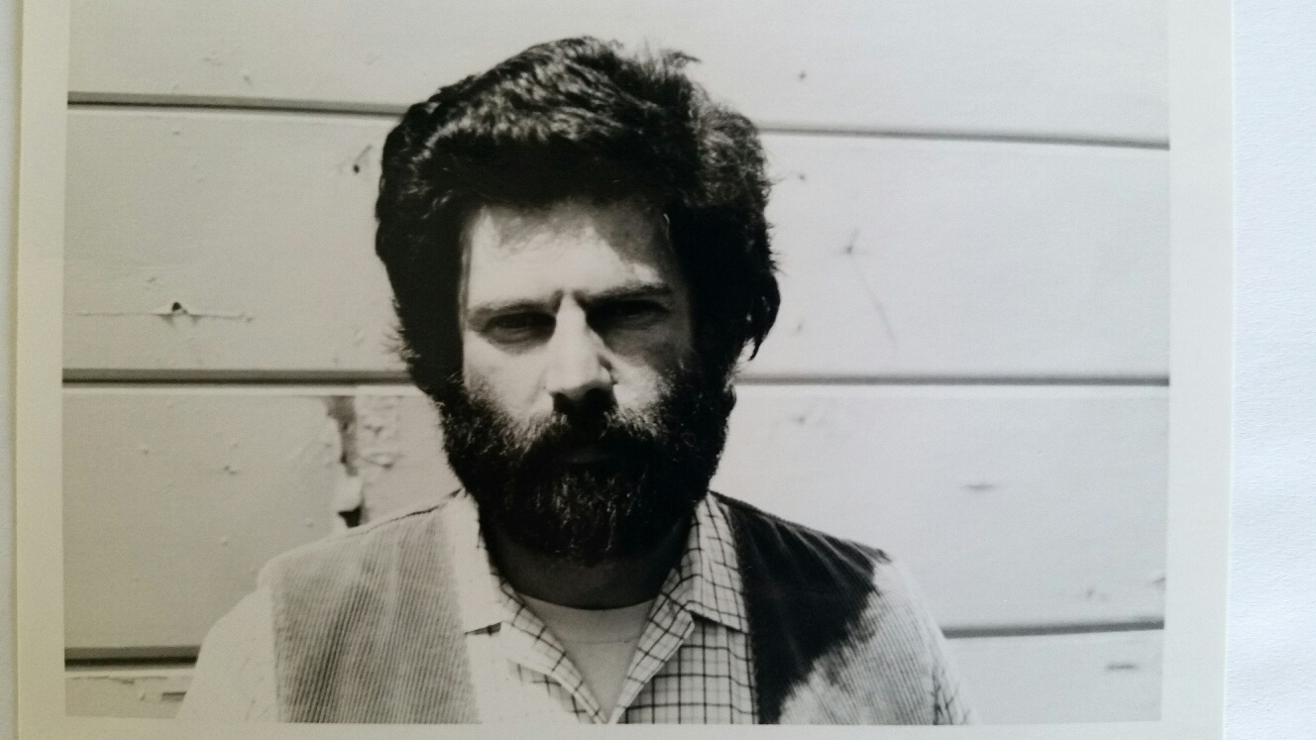
Alan Katz – RCAA Planner
Notes:
In front of the Big House?

Slide 8
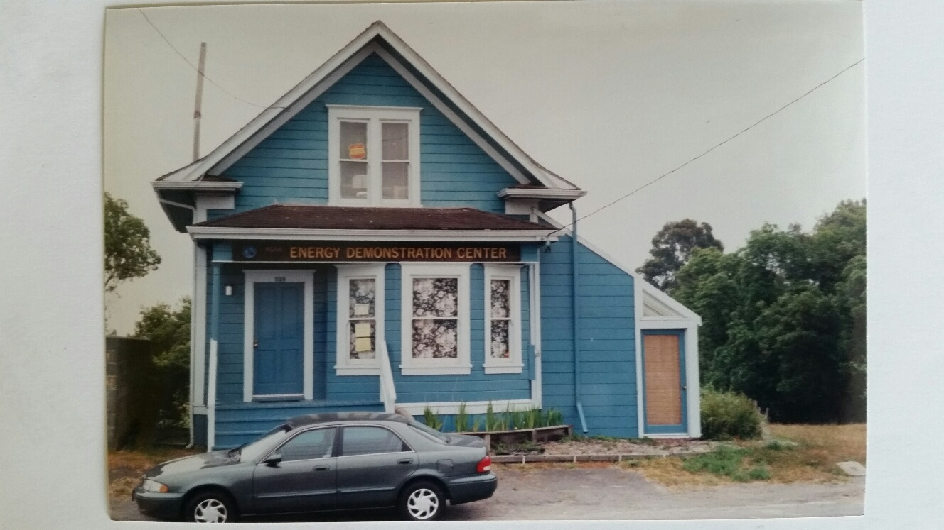
Energy Services at the Net Energy Demo House

Slide 9
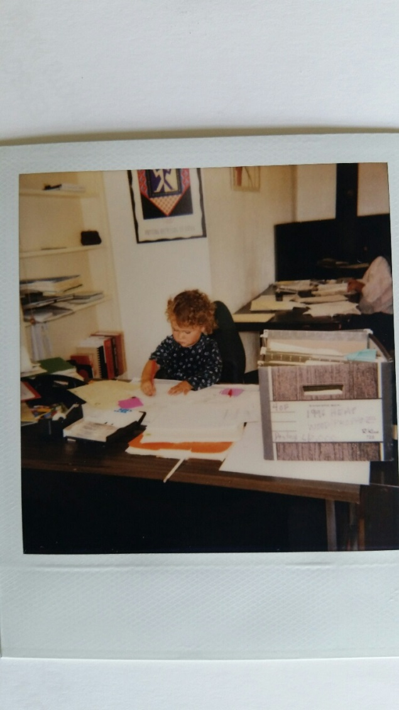
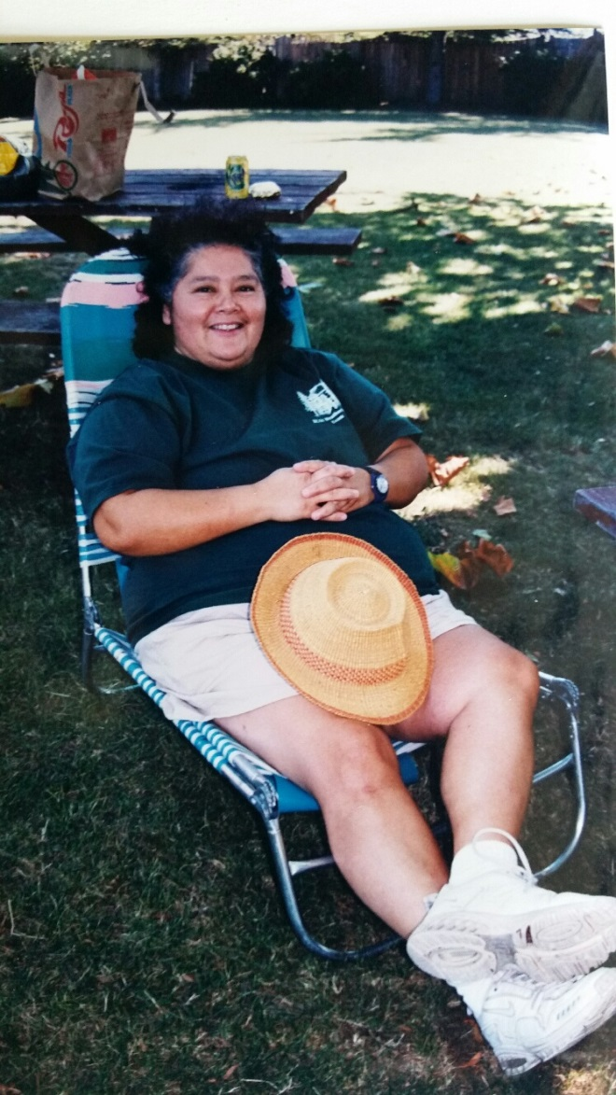
Some Younger Employees

Slide 10
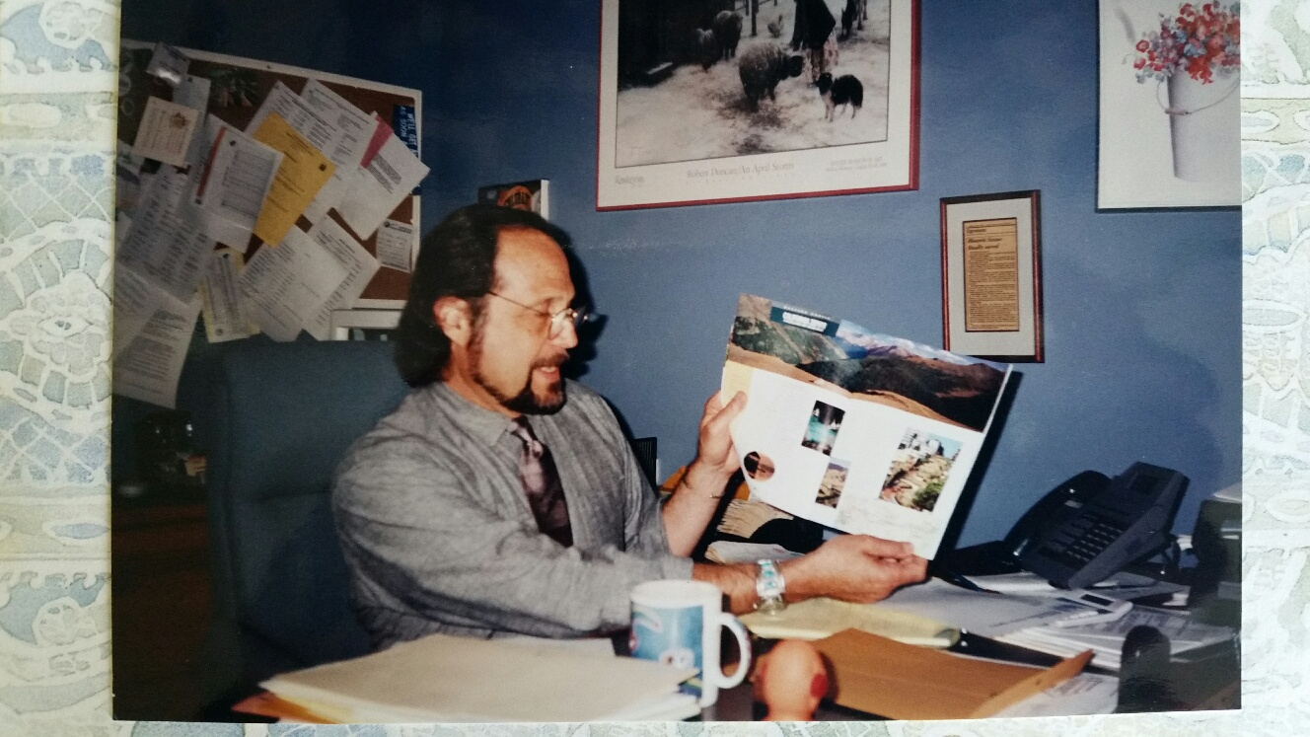
Lloyd Throne, Executive Director for 21 Years

Slide 11
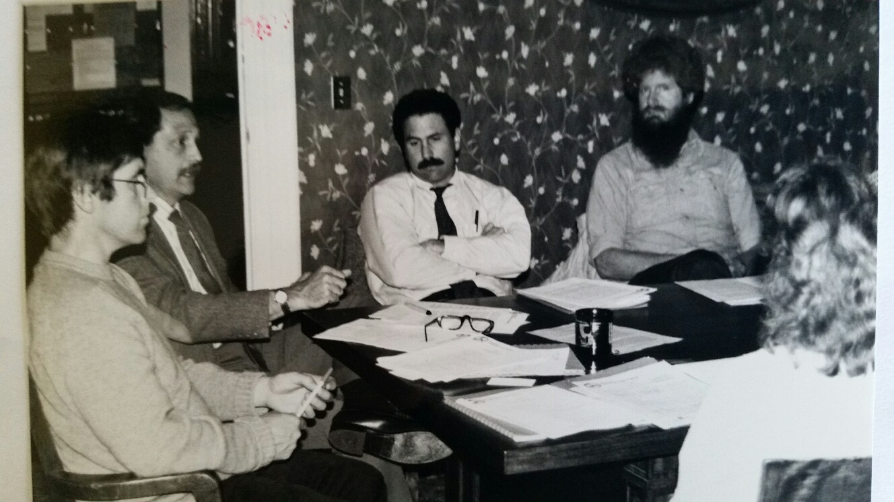
Pat Higgins, Lloyd T.,G. Koortbojian, M. Welch
Notes:
Raedelle Miller facing away

Slide 12
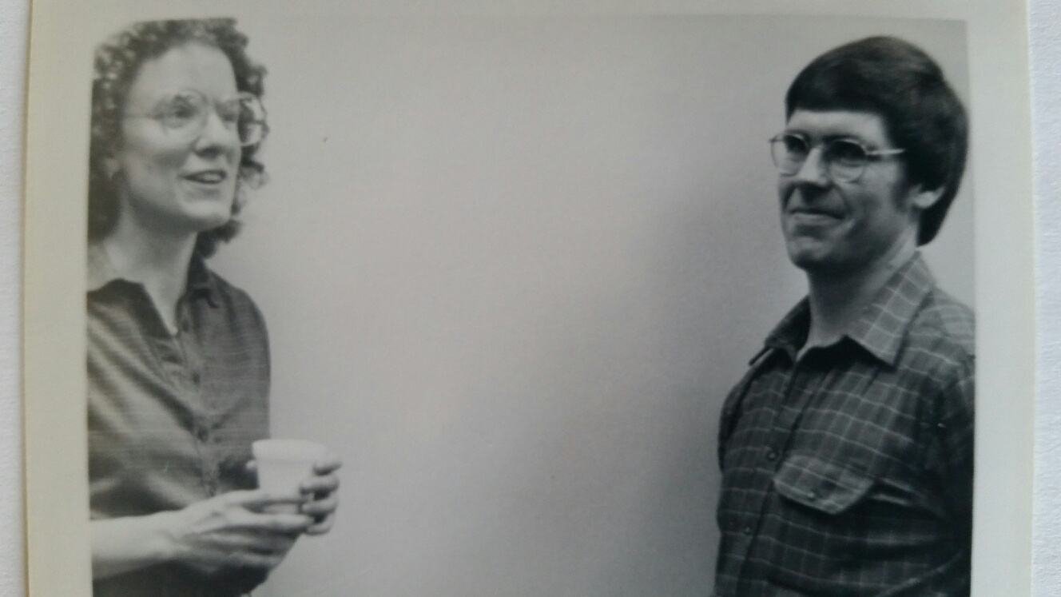
NRS Director Nancy Reichard & Pat Higgins

Slide 13
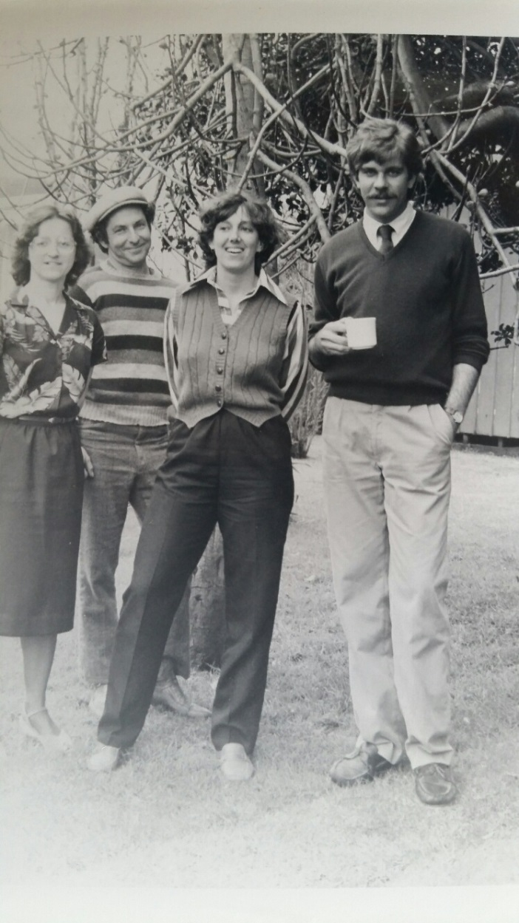
Early Staff – Lois Beechy, Steve Wrobel, etc.

Slide 14
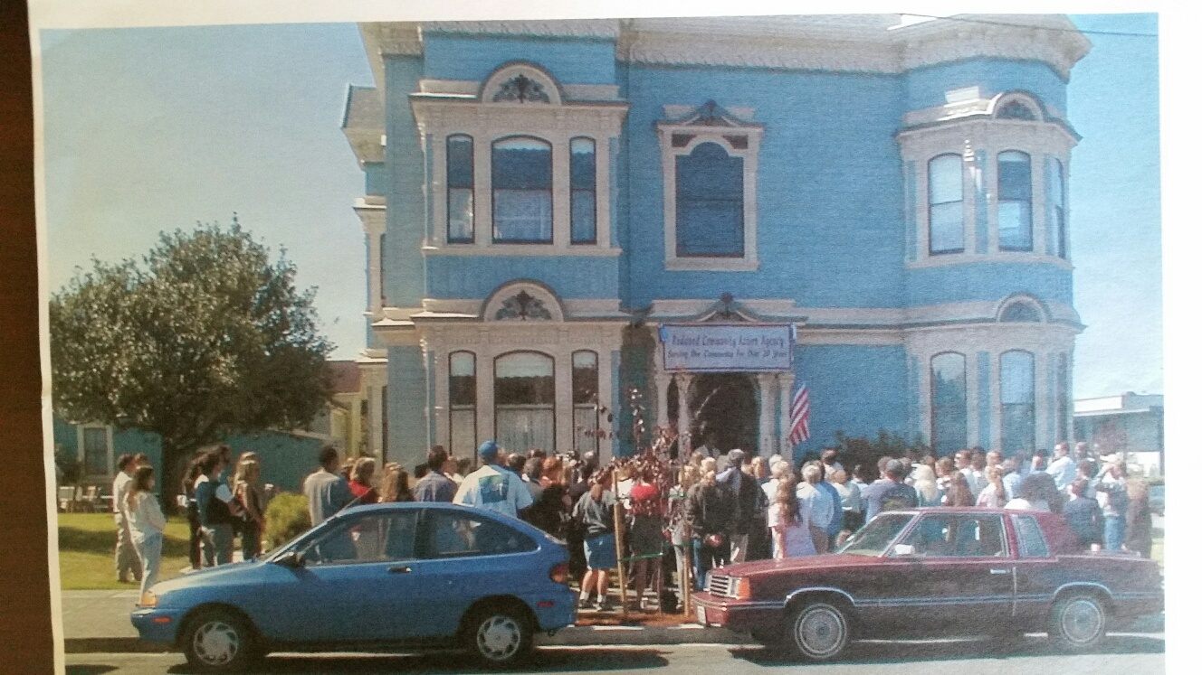
RCAA’s 20th Anniversary Party

Slide 15
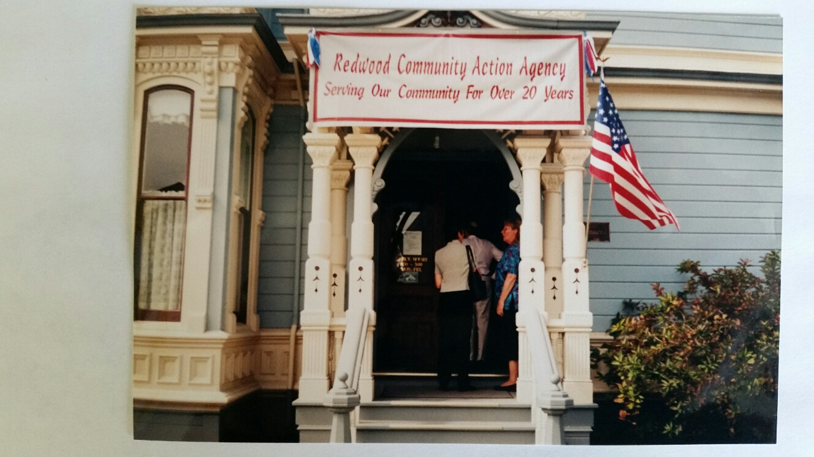
RCAA at 20 Years in 2000

Slide 16
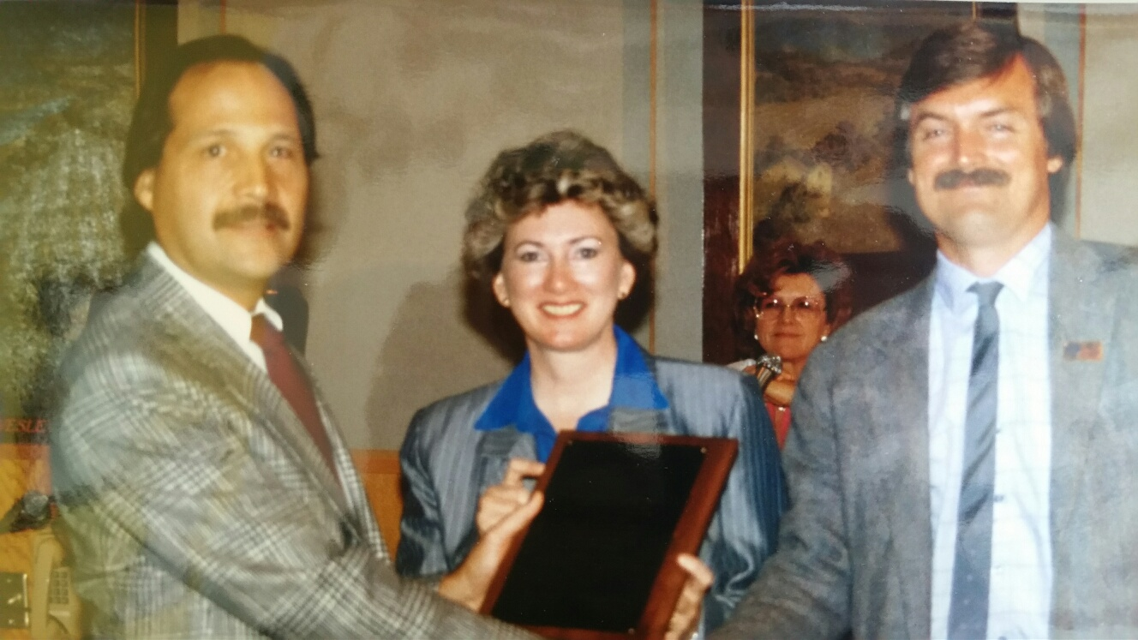
20th Anniversary Proclamation-Neely, Sparks & Chesbro

Slide 17
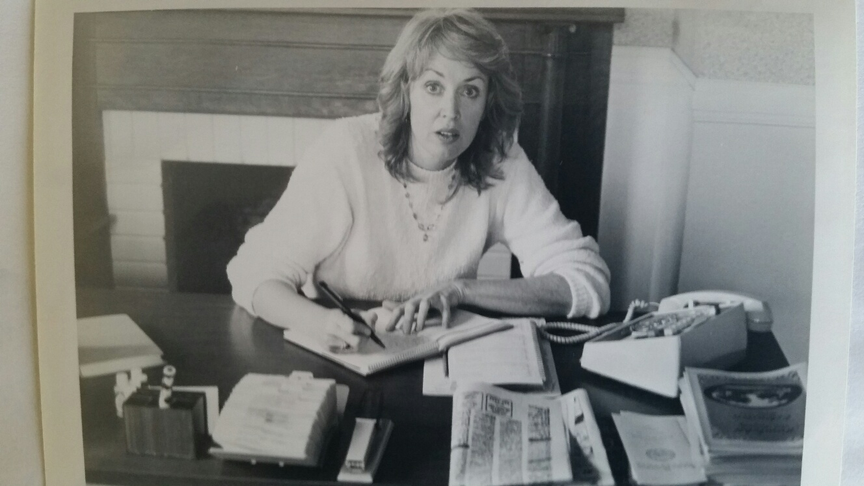
Nancy – On the Job Training Program

Slide 18
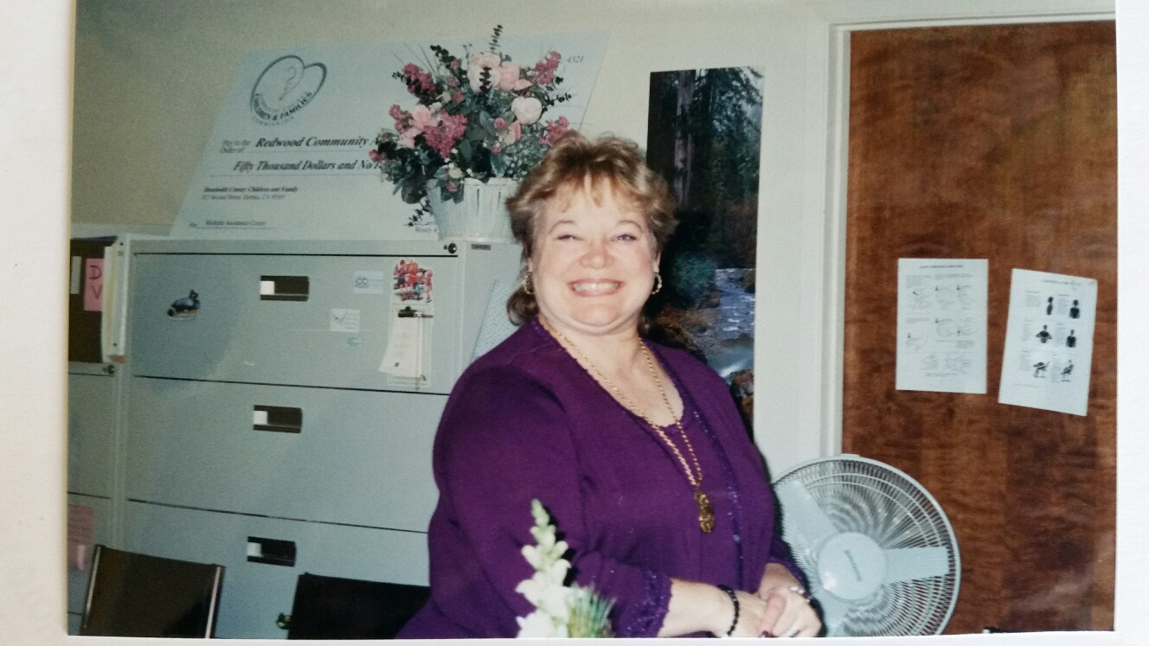
Nancy Hampton – Front Office Info & Referral

Slide 19
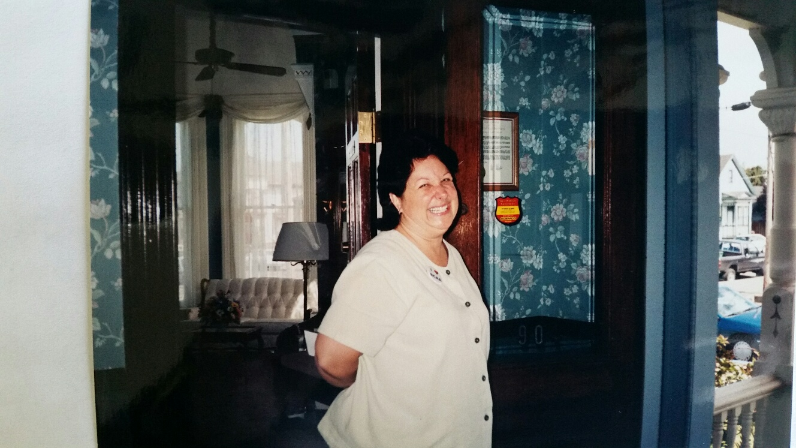
A happy Lorey Keele - must have got a grant!

Slide 20
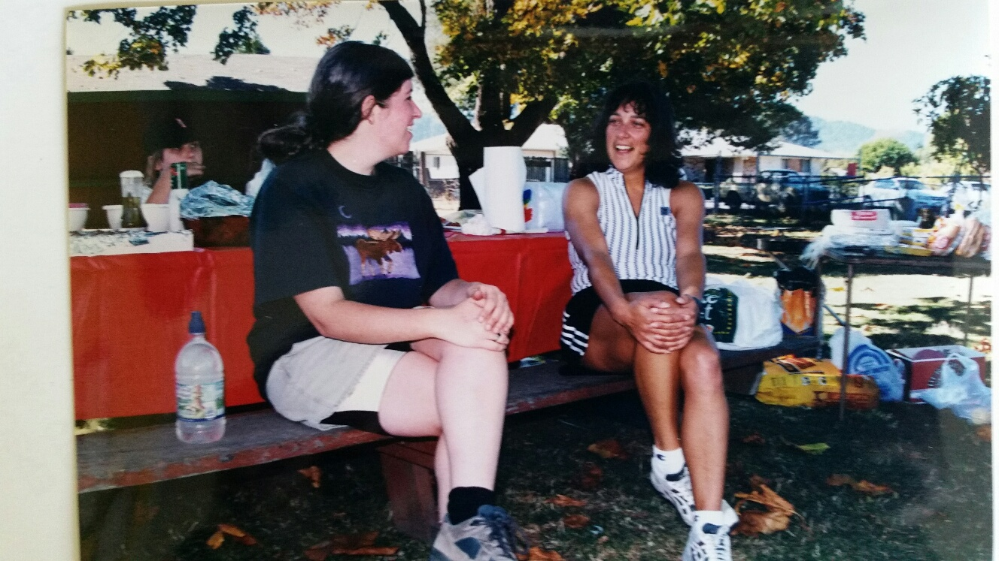
Deborah and Marlene at an RCAA Picnic

Slide 21
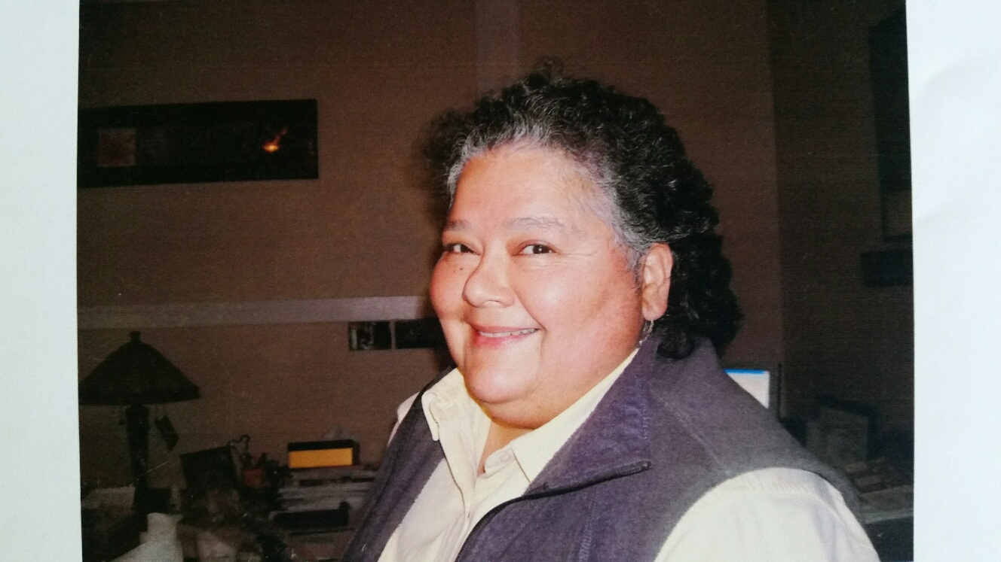
Val Martinez, the new Executive Director - 2008

Slide 22
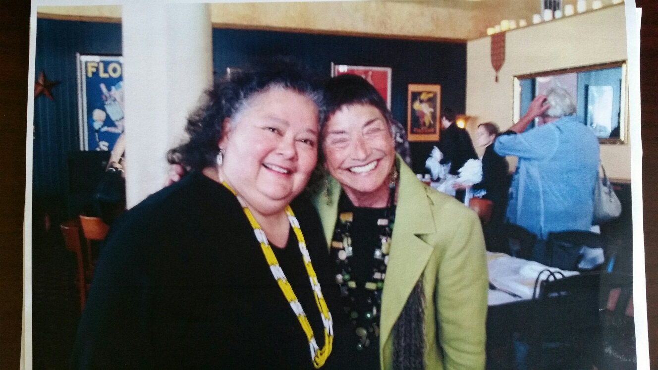
Val & Assemblywoman Patty Berg

Slide 23
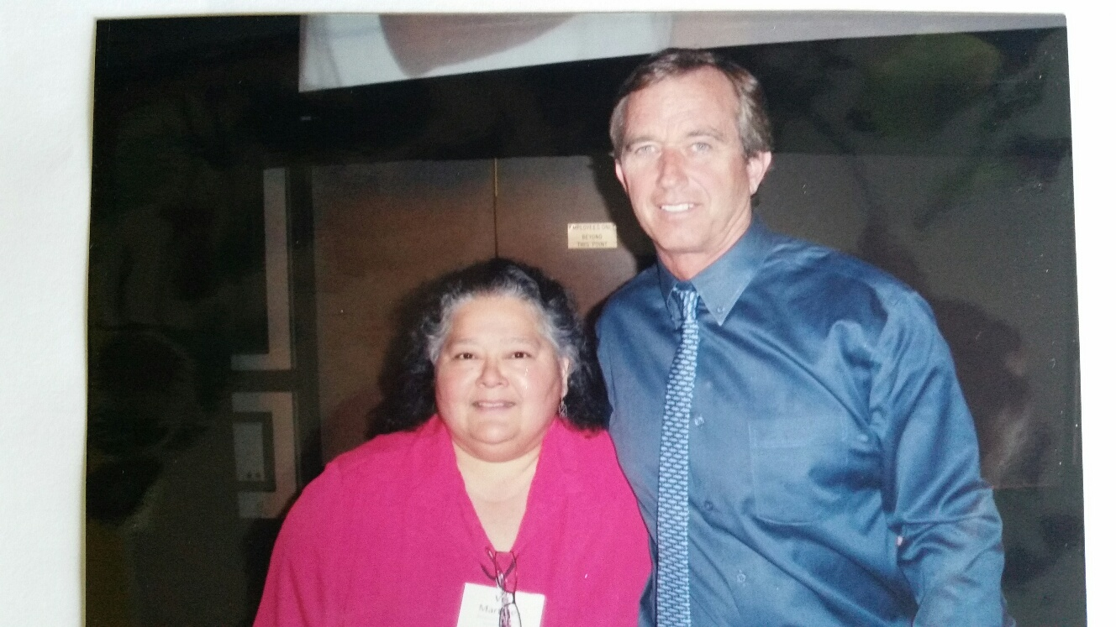
Val & Robert F. Kennedy Jr.

Slide 24
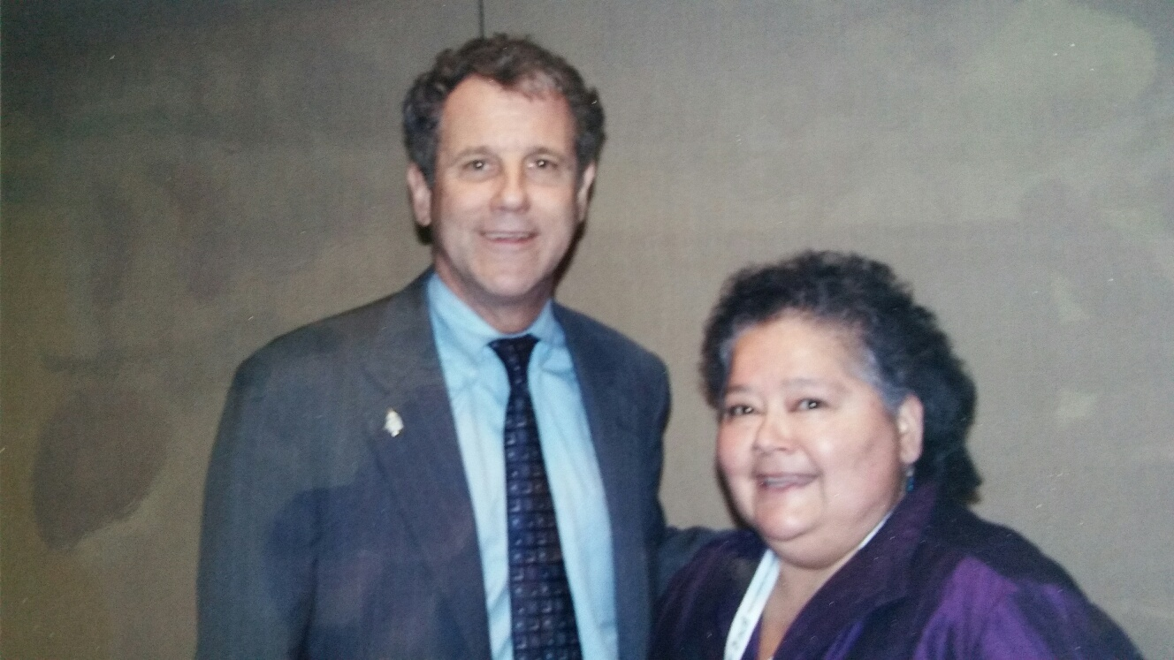
Val & Ohio Senator Sherrod Brown

